Slide 1
A DNS study of the dynamics of cluster of particles with controlled interactions in a lid-driven cavity
Chenguang Zhang¹, A'mer M Abu Shamleh¹, J.B. Joshi¹, Chunliang Wu², K. Nandakumar¹
¹Gordon A and Mary Cain Department of Chemical Engineering Louisiana State University, Baton Rouge, LA, 70810 ²ANSYS, Inc., 10 Cavendish Court, Lebanon NH 03766
Aug. 7, 2018

Slide 2
Outline
Introduction
EPIC @ LSU goals
Long-term goal of this project: to understand fluid-particle interaction using DNS as a tool under controlled conditions
Methodology – IBM as a tool using OpenFOAM
Particles in lid-driven cavity as a “closed model system”
Dynamics of a single particle
Dynamics of a row of five particles
Dynamics of a lattice of particles

Slide 3
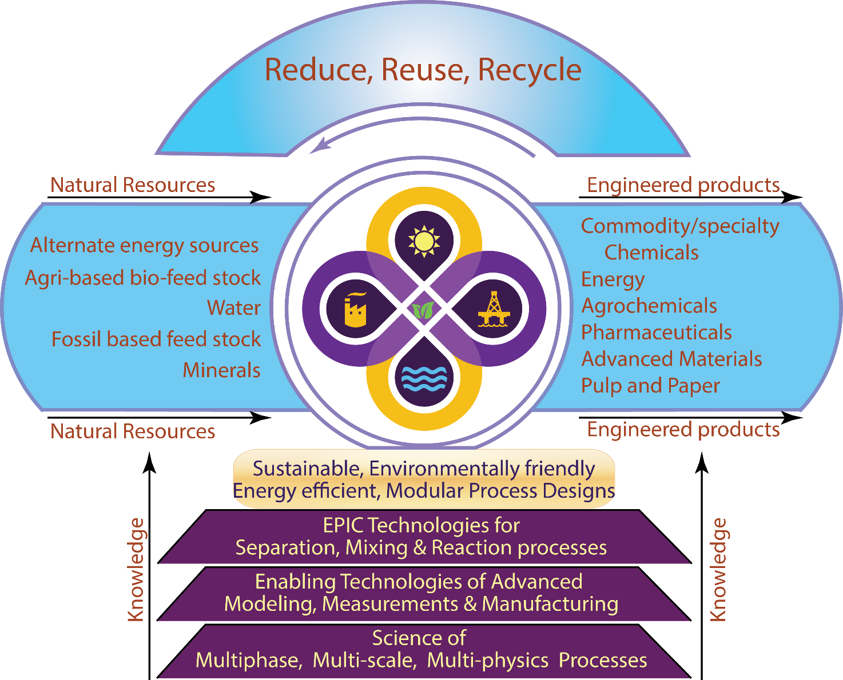
EPIC @ LSU - Vision
EPIC@LSU Vision:
Apply existing multiphase flow models to understand and improve plant operations – pragmatic in us!
Develop modelling & simulation tools applicable at various scales (DNS,DEM,TFM) and validate them with detailed data, often with structured transitions to improve model fidelity – skeptical in us!
Detailed validation studies for particulate systems
Rayleigh-Taylor, Rotating drum, Suspension droplet dynamics, Pulsed fluidized beds

Slide 4
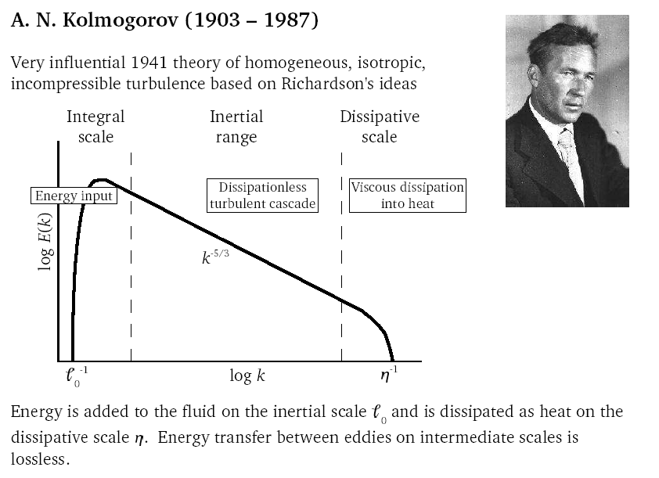
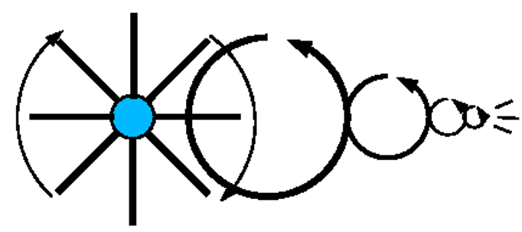
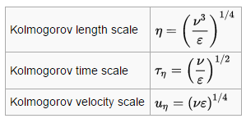
Universality in single phase turbulent flows Kolmogorov’s insight on turbulence
From the conceptual framework of Richardson
Big whorls have little whorls That feed on their velocity And little whorls have lesser whorls And so on to viscosity
to scaling arguments put forward by Kolmogorov (K42 theory) and confirmed by certain DNS simulations, a firm picture of certain universal features of turbulence in single phase flows has emerged. It has served us well in developing practical turbulence models for engineering purposes although turbulence eludes complete understanding in a fundamental sense.
Mathematicians always wish mathematics to be as ‘pure’ as possible, i.e. rigorous, provable. But usually most interesting real problems that are offered to us are inaccessible in this way. And then it is very important for a mathematician to be able to find himself approximate, non-rigorous but effective ways of solving problems.

Slide 5
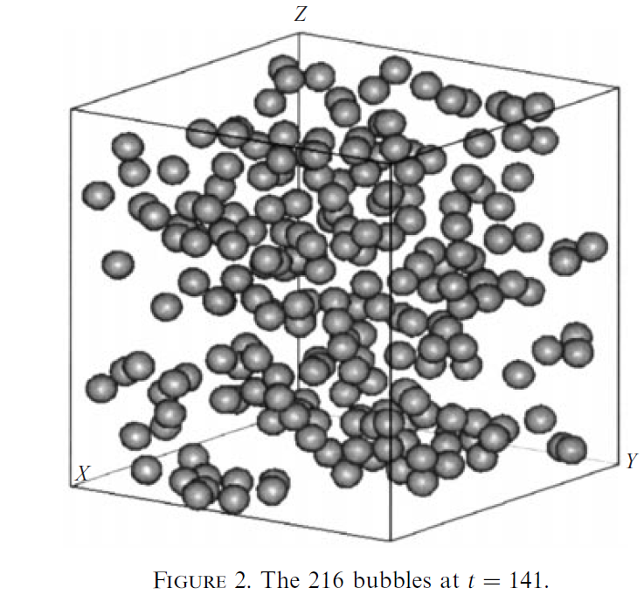
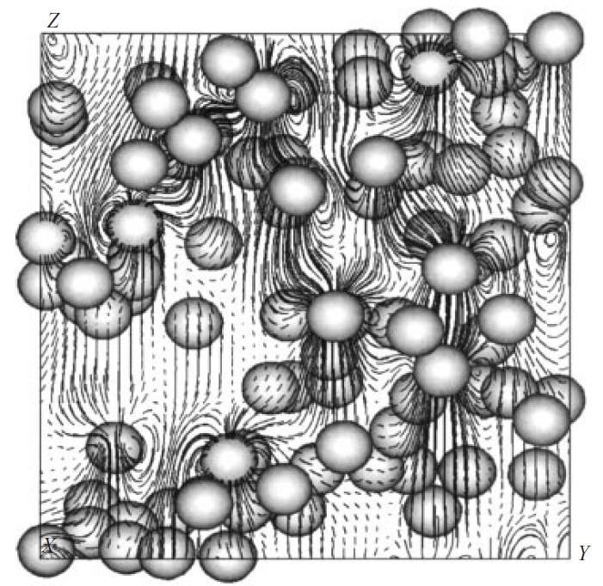
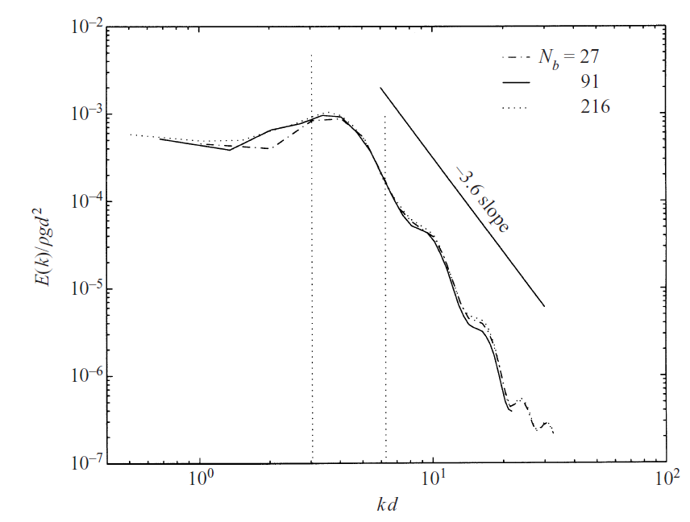
Universality in single phase turbulent flows Do they exist in multiphase flows?
DNS of bubble dynamics using front tracking by Bunner & Tryggvason, JFM (2002)
Multiphase turbulent flows raise many more questions
How is the energy input on large scale distribute among the phases? (stirred tank with suspension of particles)
What is the relationship, if any, between the coherent structures observed in the single phase turbulence and the cluster formation in the dispersed phases?
Density differences in the phases in a gravitational or centrifugal force field creates motion and injects energy on the small scale (dispersed phase scales); can it create larger scale motions in an inverse cascade phenomena.
What is the nature of turbulence interaction between the continuous phase and the dispersed phase?
Literature exists on all these questions attempting to develop partial answers

Slide 6
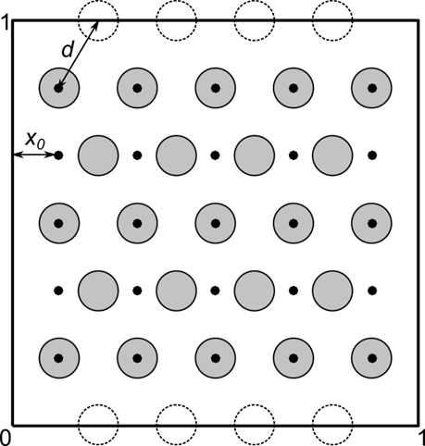
Problem setup
We study the dynamics of cluster of identical particles that are fixed-in-space, but free-to-rotate.
A $1×1$ square with top side moving at $U=1$
Dynamics characterized by steady-state particle rotation speed w ($Re≤150$).
Goal: to understand the effect of particle arrangement on fluid-particle interaction

Slide 7
Methodology
Dimensionless parameters:
Reynolds number $Re =1/ν$
geometric parameters: particle size and arrangement
Direct numerical simulation using immersed boundary method

Slide 8
Immersed Boundary Method
CFD solver based on projection method + rigid body dynamics
Volume averaged direct forcing formulation
Accurate volume fraction calculation based on signed distance field
Fluid solver
$$\frac{u^{\text{∗}}−u^{n}}{Δt}=−\left(U^{n}⋅∇\right)u^{\text{∗}}+ν∇^{2}u^{\text{∗}}$$
Create U*
$$∇^{2}p^{\text{∗}}=\frac{1}{dt}∇⋅U^{\text{∗}}$$
$$f_{s}=\frac{ε\left(u_{s}−u\right)}{Δt}$$
Solid solver
$$u^{n+1}=u^{\text{∗}}−dt∇p^{\text{∗}}$$
$$\frac{d\left(I_{s}ω\right)}{dt}=−ρ_{f}\int_{V}{r×f_{s}dV}+M_{s}$$
Solid sub-iteration
$$\frac{d\left(m_{s}v\right)}{dt}=−ρ_{f}\int_{V}{f_{S}}dV+F_{s}$$
$$u^{n+1}=\left(1−ε\right)⋅u^{n+1}+us=u^{n+1}+f_{s}Δt$$
Create Uⁿ

Slide 9
Three particle arrangements
a single particle at (X, 0.5) – X is varied
a row of five particles at ({0.1, 0.3, 0.5, 0.7, 0.9}; Y) – Y is varied
a lattice of particles – two (rectangular and triangular) configurations are explored.
→ → increasingly complex → →

Slide 10
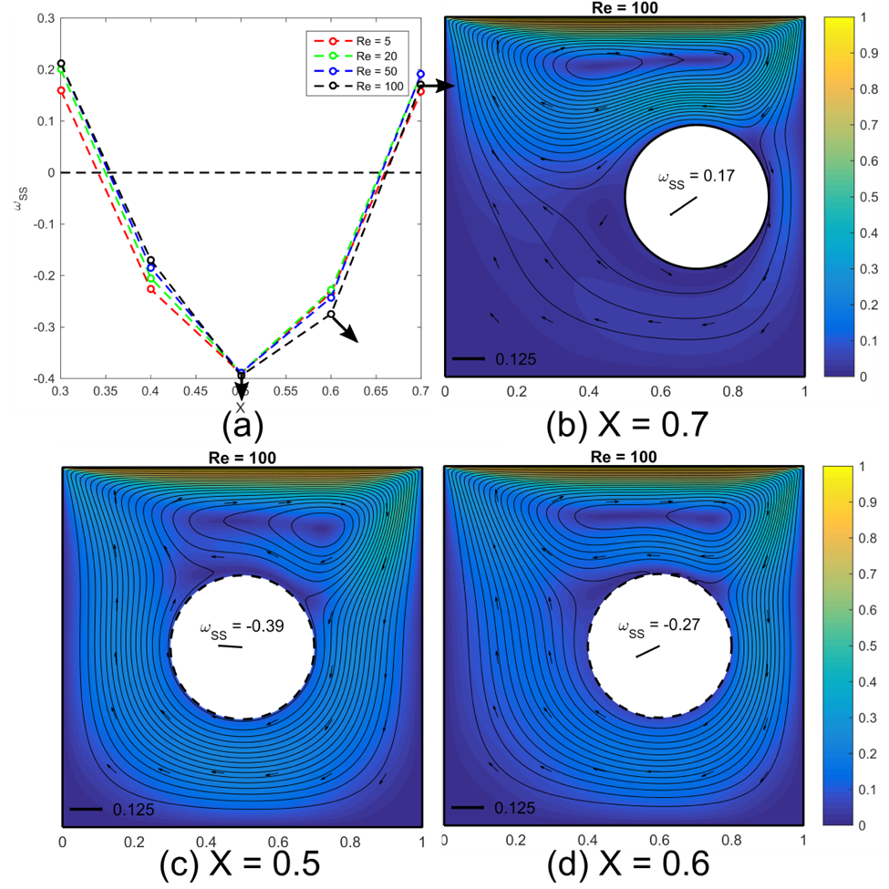
A Single Particle
radius: r = 0.2
location: (X, 0.5)
As X changes, the particle reverses its rotation direction

Slide 11
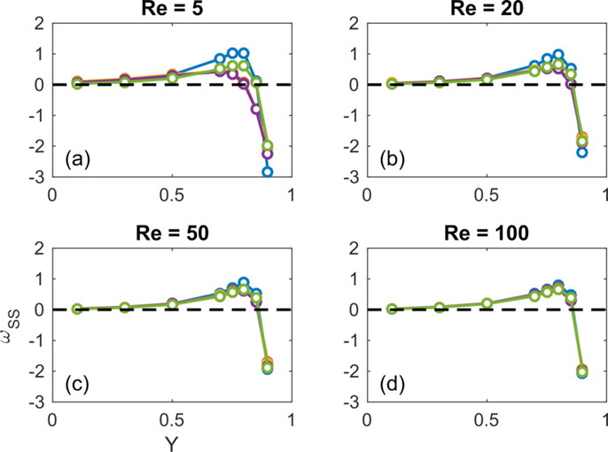
A Row of Five Particle
radius: r = 0.05
x-location: (0.1, 0.3, 0.5, 0.7, 0.9)
y-location: Y
As Y changes, all particles reverse their rotation direction

Slide 12
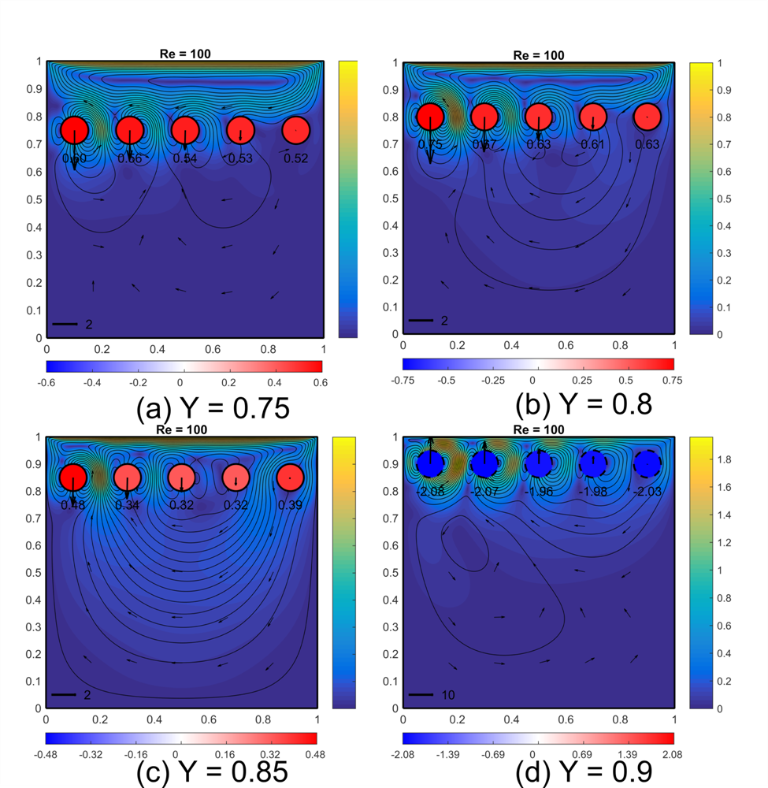
A Row of Five Particle
radius: r = 0.05
x-location: (0.1, 0.3, 0.5, 0.7, 0.9)
y-location: Y
As Y changes, all particles reverse their rotation direction

Slide 13
A Lattice of Particle
radius: r = 0.05
Two kinds of lattices with different symmetry properties:
an equilateral triangular lattice
a rectangular lattice

Slide 14
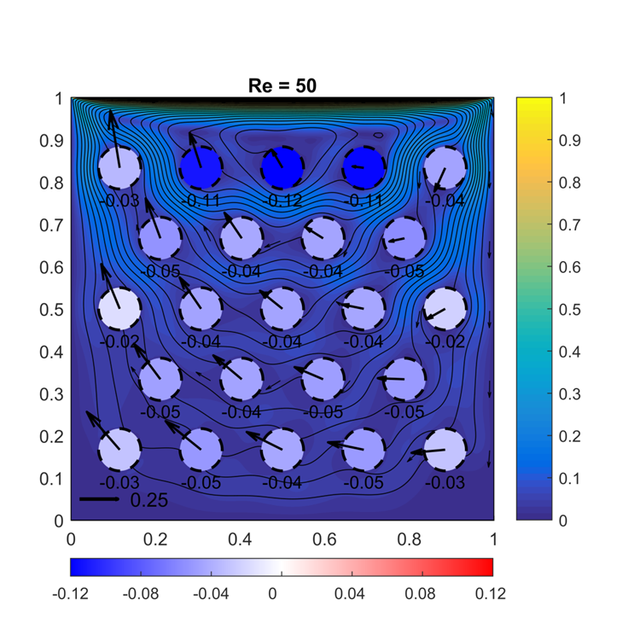
The Triangular Lattice
Particles always rotate clockwise (only three exceptions at the two lowest Re)
Flow patterns are qualitatively similar as Re changes from 5 to 150

Slide 15
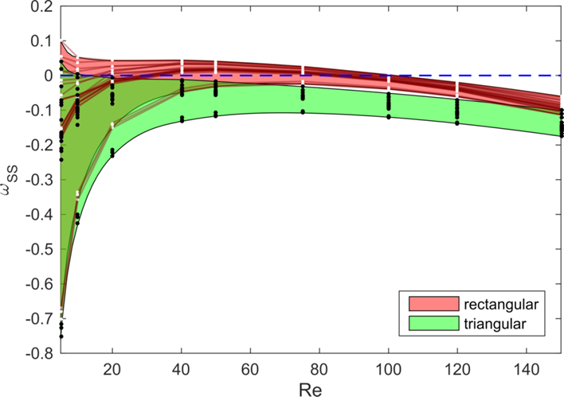
A “Phase” Diagram of the System
The collection of particle steady-state rotations is a state, or “phase” of the system
phase vs. Re gives a “phase diagram”
every crossing with the w=0 line corresponds to a reversal of rotation
particles in the triangular lattice (green region) almost never reverse

Slide 16
The Rectangular Lattice
Transition A
Transition B
22 of 25 particles in the rectangular lattice reverse rotation once or twice as Re increases

Slide 17
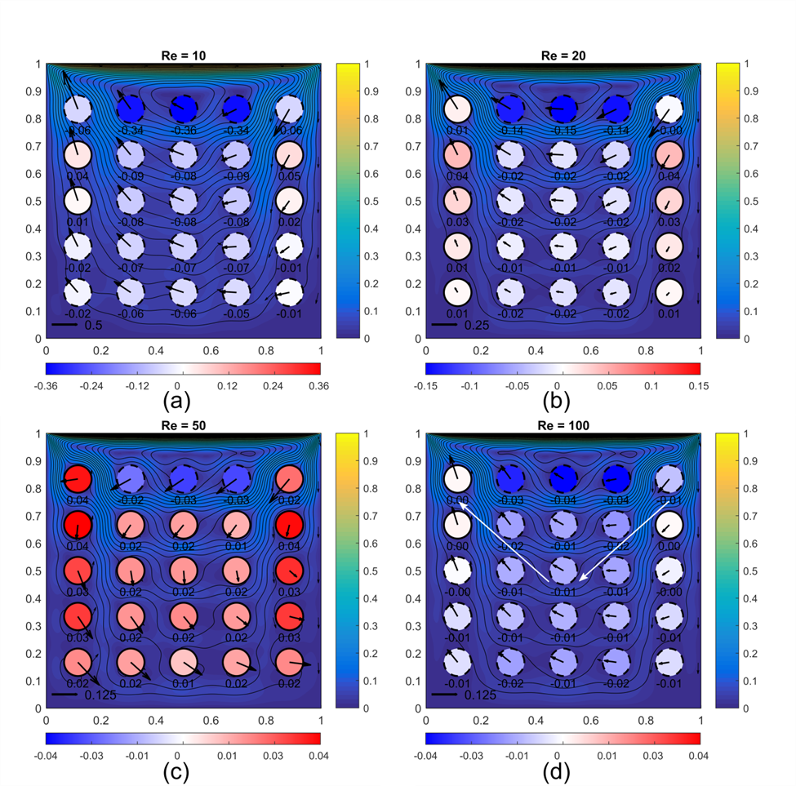
Transition A
Between Re = 20 and 50
Cause: the circulation between the lid and the first-row particles closes within this gap
The flow at the bottom of this circulation is towards the left

Slide 18
From Transition A to B
From Re = 20 to 50, streamlines get sharper
This trend cannot continue indefinitely
From Re = 50 to 100, the streamlines actually get smoother, and transition B occurs

Slide 19
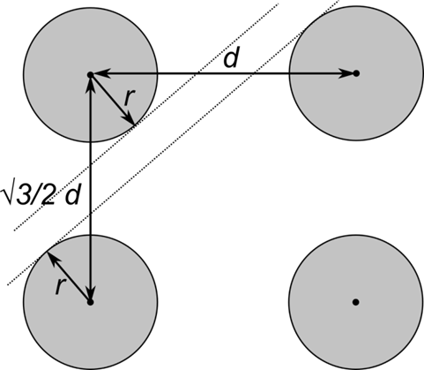
Hypothesis of Secondary Channel
There is primary axis-aligned channel → sharp streamlines
There is also secondary diagonal channel → its “activation” causes transition B

Slide 20
Test of Hypothesis
The secondary channel disappears if r increases to a critical value rc (by the way, the primary channel still exists at r = rc)
Transition B shall also disappear as r → rc

Slide 21
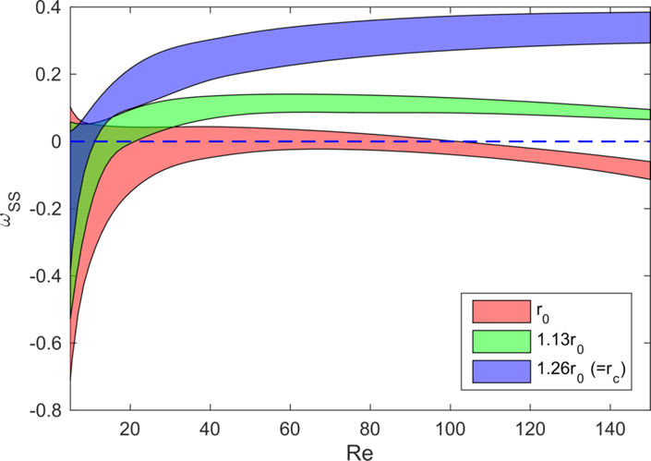
Two larger particle radius (rect)
Transition B disappears
Transition B delayed
Original r = r0 = 0.05

Slide 22
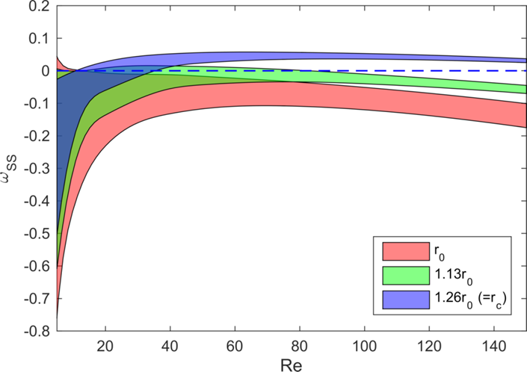
Two larger particle radius (tri)
Transition B??
As Re↑, particles always return to clockwise rotation

Slide 23
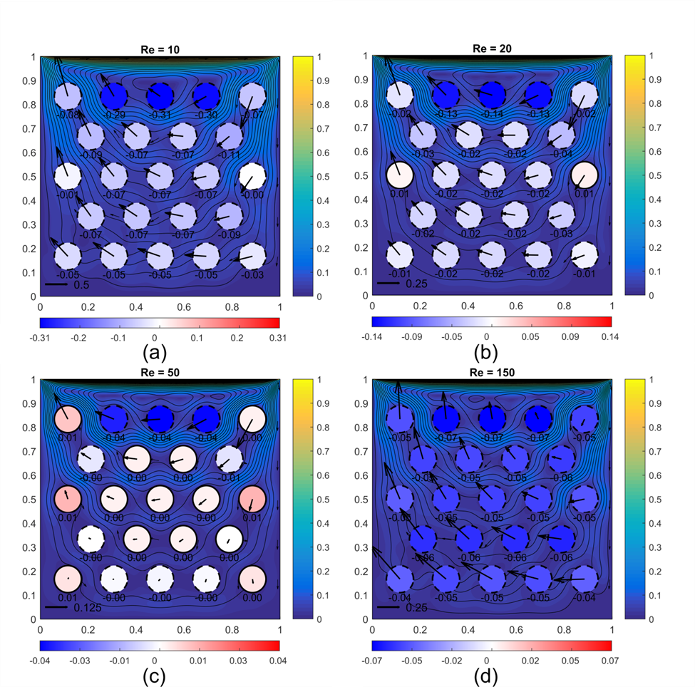
A Different “Transition B”
No secondary channel to activate
“Transition B” is caused by the closing and re-opening of the circulation between the lid and first-row particles
The Re = 150 pattern after “transition B” is similar to Re = 10 pattern

Slide 24
Conclusion
Reversal of particles’ rotation is common as their arrangement is changed
The triangular lattice behaves consistently as flow condition (Re) changes
Due to the secondary channel, the rectangular lattice has non-trivial phase transition as particle size changes
More degrees of freedom and complex shapes in the future

Slide 25
Thanks!
The EPIC group at LSU

